Slide 1
CG2271 Real Time Operating Systems
Lab Lecture 8
UART Programming
(Reference Guide Chapter 38)

Slide 2
Introduction
Lab Lecture 8 – UART Programming

Slide 3
Introduction
The Universal Asynchronous Receiver Transmitter (UART) is one of the oldest and most common serial transmission technologies:
  Serial – Data is sent one bit at a time.
  Asynchronous – There is no clocking signal coordinating the sender and receiver.
    Instead the sender signals the receiver that it is about to transmit.
    The transmitter then sends data at an agreed data rate, and the receiver samples (reads) the data at the same agreed data rate.

Slide 4
Transmitter Basics
Data
bits
Data Sampling Time at Receiver
T_{bit}
T_{bit}
T_{bit}
T_{bit}
T_{bit}
T_{bit}
T_{bit}
T_{bit}
T_{bit}
T_{bit}
T_{bit}
Time Zero
If no data to send, keep sending 1 (stop bit) – idle line
When there is a data word to send
  Send a 0 (start bit) to indicate the start of a word
  Send each data bit in the word (use a shift register for the transmit buffer)
  Send a 1 (stop bit) to indicate the end of the word

Slide 5
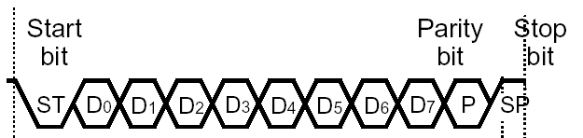
Receiver Basics
Data
bits
Data Sampling Time at Receiver
Time Zero
T_{bit}*1.5
T_{bit}*2.5
T_{bit}*3.5
T_{bit}*4.5
T_{bit}*5.5
T_{bit}*6.5
T_{bit}*7.5
T_{bit}*8.5
T_{bit}*9.5
T_{bit}*10.5
Wait for a falling edge (beginning of a Start bit)
  Then wait ½ bit time
  Do the following for as many data bits in the word
          Wait 1 bit time
          Read the data bit and shift it into a receive buffer (shift register)
  Wait 1 bit time
  Read the bit
          if 1 (Stop bit), then OK
          if 0, there’s a problem!

Slide 6
For this to work…
Transmitter and receiver must agree on several things (protocol)
  Order of data bits
  Number of data bits
  What a start bit is (1 or 0)
  What a stop bit is (1 or 0)
  How long a bit lasts
    Transmitter and receiver clocks must be reasonably close in frequency, since the only timing reference is the start of the start bit

Slide 7
MCXC444 UARTs
LPUART0, LPUART1
  Low Power
  Can oversample from 4x to 32x
UART2
  More basic, fewer features, easier to program.
  Supports only 16x oversampling.
  Combined with FlexIO, a unit that can emulate various serial interfaces.
    UART, I2C, SPI, PWM generation, …

Slide 8
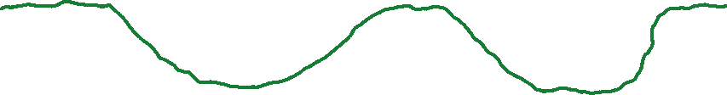
Input Data Oversampling
When receiving, UART oversamples incoming data line
  Extra samples allow voting, improving noise immunity
  Better synchronization to incoming data, improving noise immunity
LPUART0 and LPUART1 rovides configurable oversampling from 4x to 32x
  Put desired oversampling factor minus one into UART0 Control Register 4, OSR bits.
UART2 has fixed 16x oversampling

Slide 9
programming uart2
Lab Lecture 8 – UART Programming

Slide 10
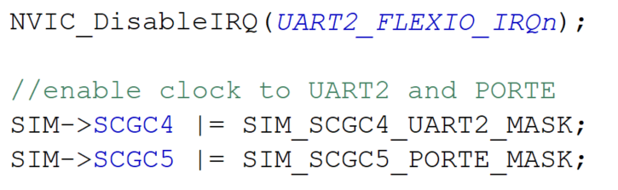
Clock Gating
As always we start by disabling interrupts, then turn on the clock gating for UART2 in the SIM_SCGC4 register:
We also turn off the transmitter and receiver using the TE and RE bits in UARTx_C2 (see later):

Slide 11
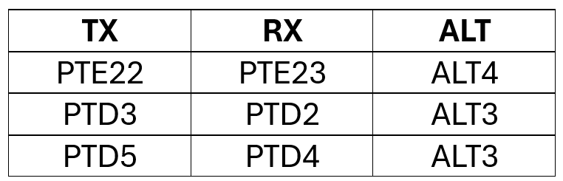
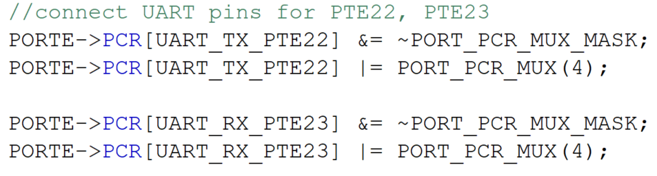
Setting Pins to UART
There are several pins that can be set to be TX and RX pins for UART2.
We will use PTE22 and PTE23.

Slide 12
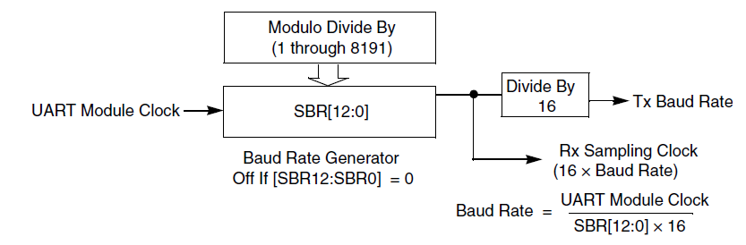
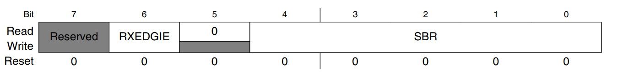
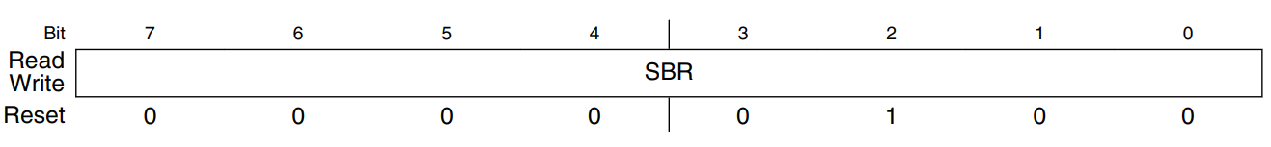
Baud Rate Generator
The baud rate is controlled by the 13-bit divisor SBR[12:0], created using UARTx_BDH and UARTx_BDL:

Slide 13
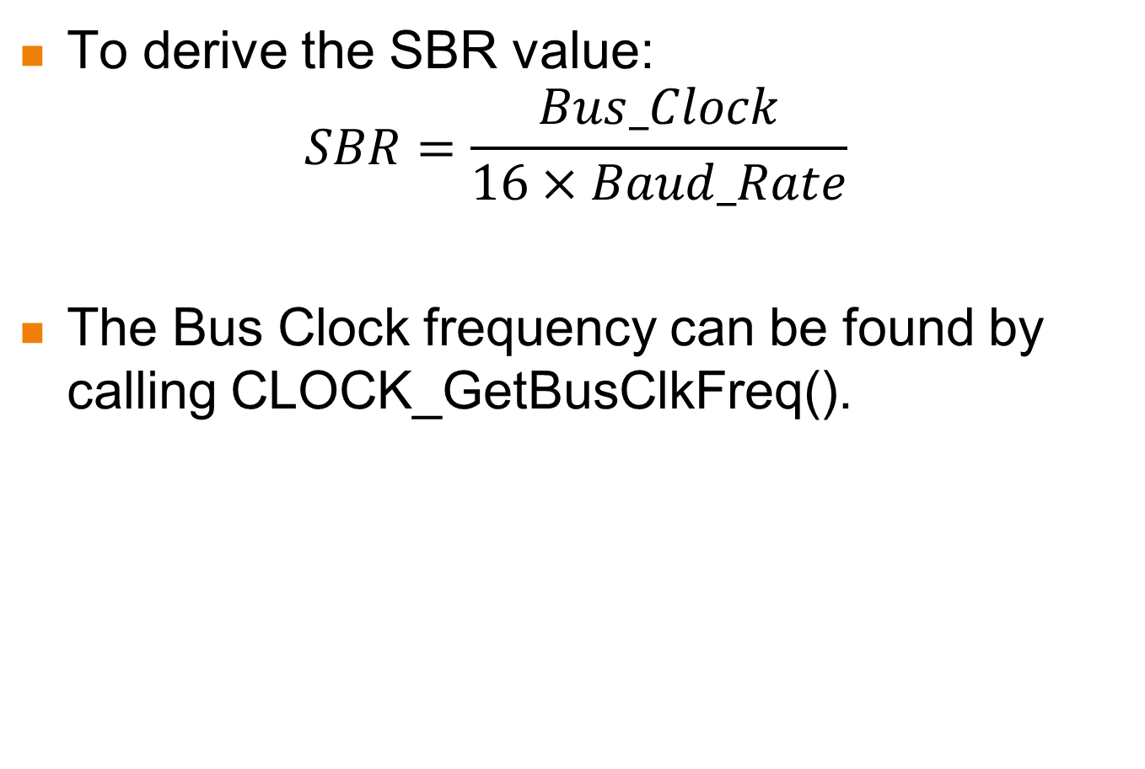
Baud Rate Generator
To derive the SBR value:
$$SBR=\frac{Bus_Clock}{16×Baud_Rate}$$
The Bus Clock frequency can be found by calling CLOCK_GetBusClkFreq().

Slide 14
Baud Rate Generator
Integer Rounding Trick:
  Integer divisions always round down.
    Issue: 3.75 will round down to 3, leading to big errors.
  Trick:
    Add 0.5 so we always round correctly.
    E.g. 3.1 should be rounded down to 3:
      3.1 + 0.5 = 3.6, which will round down to 3.
    3.6 should be rounded up to 4:
      3.6 + 0.5 = 4.1, which will round down to 4.
However adding 0.5 requires floating point operations.
  MCXC444 only has slow software emulation.

Slide 15
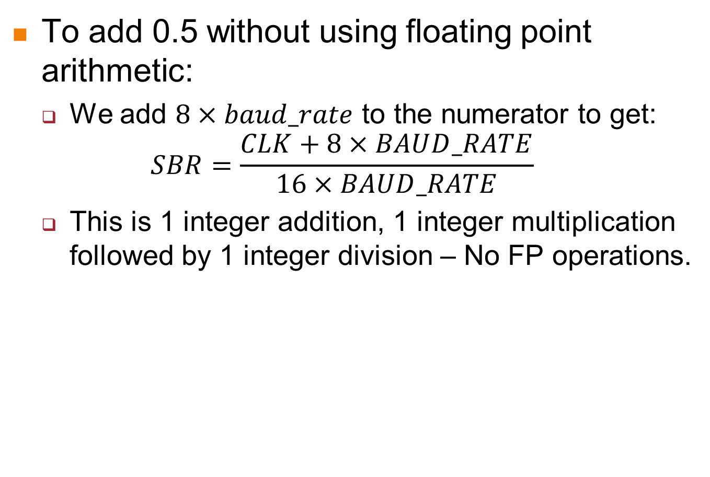
Baud Rate Generator
To add 0.5 without using floating point arithmetic:
  We add $8×baud_rate$ to the numerator to get:
  $$SBR=\frac{CLK+8×BAUD_RATE}{16×BAUD_RATE}$$
  This is 1 integer addition, 1 integer multiplication followed by 1 integer division – No FP operations.

Slide 16
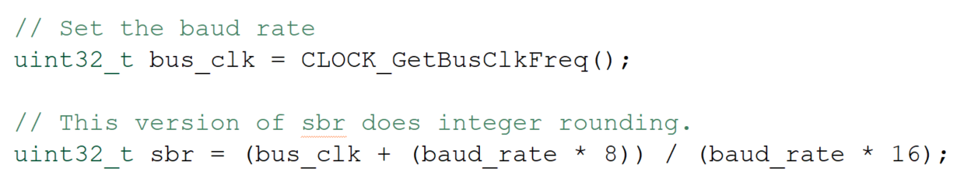
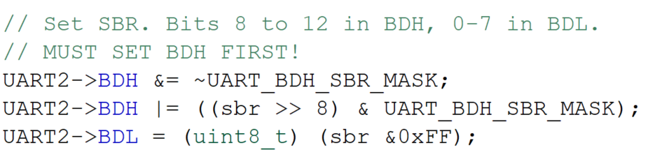
Baud Rate Generator
Derive the SBR divisor:
Set BDH and BDL
  Note: BDH MUST be written first!

Slide 17
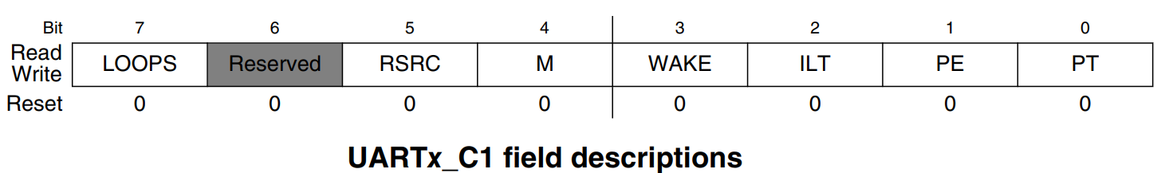
UART Control Register 1 (UART0_C1)
LOOPS: Enables loopback/single-pin (TX/RX) mode
RSRC: Selects between loopback and single-pin mode
M: Select 9-bit data mode (instead of 8-bit data)
WAKE: Wakeup method
ILT: Idle line type
PE: Parity enabled with 1
PT: Odd parity with 1, even parity with 0

Slide 18

UART Control Register 2 (UART0_C2)
Interrupt Enables
  TIE: Interrupt when Transmit Data Register is empty
  TCIE: Interrupt when transmission completes
  RIE: Interrupt when receiver has data ready
Module Enables (We used these earlier to disable the transmitter and receiver)
  TE: Transmitter enable
  RE: Receiver enable
Other
  RWU: Put receiver in standby mode, will wake up when condition occurs
  SBK: Send a break character (all zeroes)

Slide 19
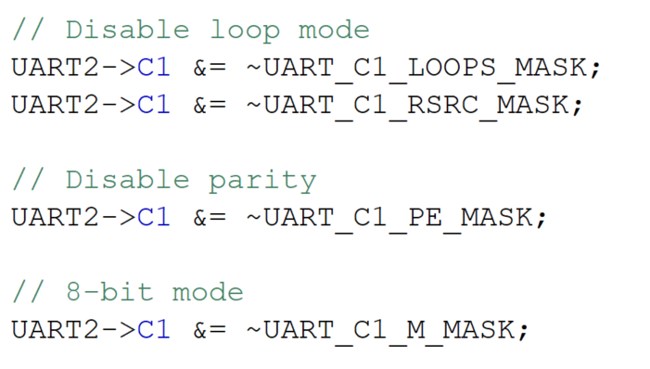
Configuring UART2

Slide 20
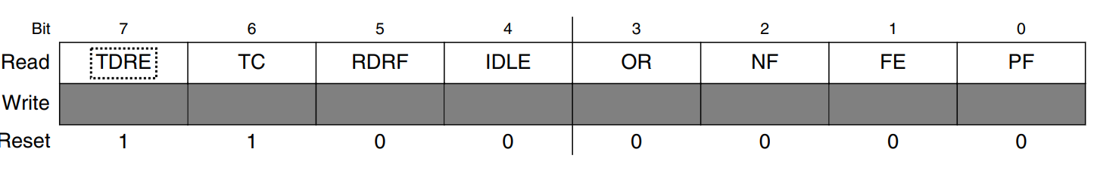
UART Status Register 1 (UART_S1)
TDRE: Transmit data register empty, can write more data to data register
TC: Transmission complete.
RDRF: Receiver data register full, can read data from data register
IDLE: UART receive line has been idle for one full character time
OR: Receive overrun. Received data has overwritten previous data in receive buffer
NF: Noise flag. Receiver data bit samples don’t agree.
FE: Framing error. Received 0 for a stop bit, expected 1.
PF: Parity error. Incorrect parity received.
To clear a flag:
  Read UARTx_S1, then either read or write UARTx_D.

Slide 21
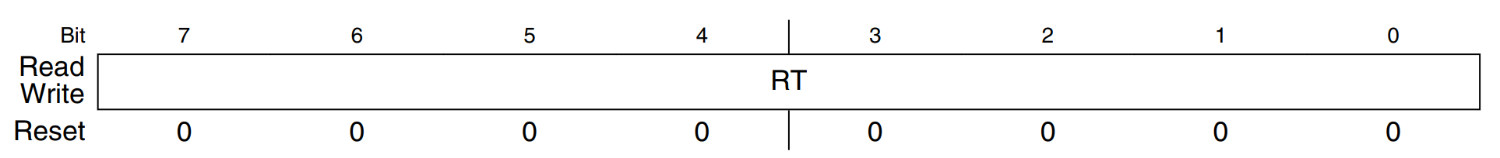
UART Data Register
The UART data register UARTx_D is used to transmit/receive data.
  Writing to UARTx_D sends data to “the other side”.
  Reading from UARTx_D reads data sent by “the other side”.
  Reading/Writing UARTx_D automatically clears TDRF and RDRF in UARTx_S1.
Important:
  If using parity, only bits 0 to 6 are data bits while bit 7 is the parity bit. Remember to mask it off.

Slide 22
Polling
void UART2_Transmit_Poll(uint8_t data) {
// wait until transmit data register is empty
while (!(UART2->S1 & UART_S1_TDRE_MASK));
UART2->D = data;
}
uint8_t UART2_Receive_Poll(void) {
// wait until receive data register is full
while (!(UART2->S1 & UART_S1_RDRF_MASK));
return UART2->D;
}
Notes:
This code sends or receives a byte of data, performing busy waiting as needed. Each function blocks as needed: the transmit function does not return until it has been able to send its byte. The receive function does not return until it has a byte. If no data is ever received, then this function will never return and the program will be stuck here.

Slide 23
Using Interrupts
We will now look at how to use interrupts:
  There is one single interrupt vector: UART2_FLEXIO_IRQn
  You need to check for a specific event within the UART2_FLEXIO_IRQHandler ISR.
    Data received.
    Ready to transmit next data.
    Errors (not covered here).
Interrupts are asynchronous:
  Can come at any time.
  Need buffers to store characters received/to be sent.

Slide 24
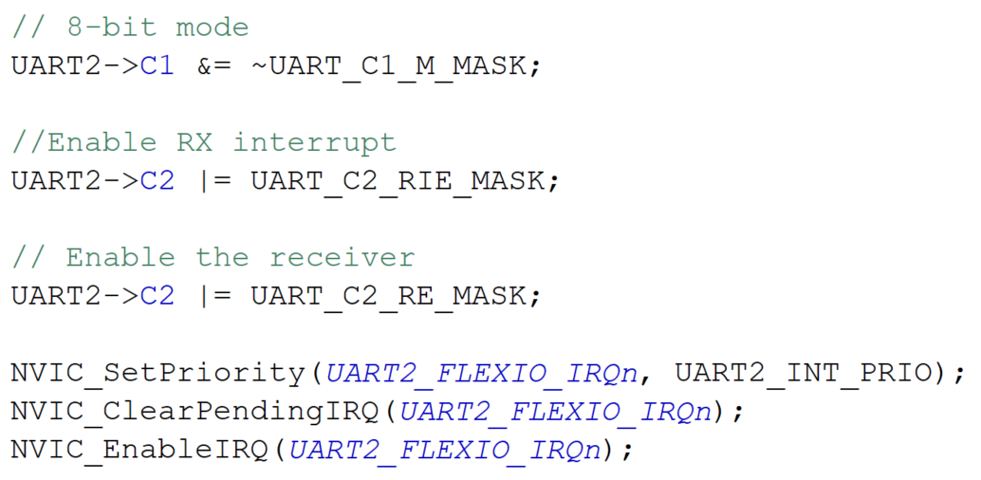
Using Interrupts
To use interrupts, we must set the Receive Interrupt Enable (RIE) and Transmit Interrupt Enable (TIE) bits of UARTx_C2 to 1.
  Must also enable the receiver (RE) and transmitter (TE) bits. Set IRQ priority and enable interrupts. Here we will only enable the receiver.

Slide 25
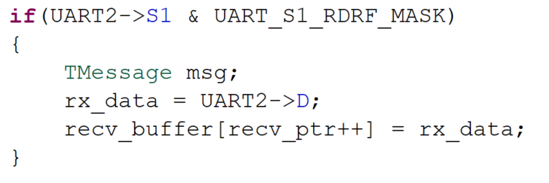
Using Interrupts
Writing the ISR:
  All UART interrupts are handled by UART2_FLEXIO_IRQHandler.
  Let’s look at the receiver code first:
    Each time a character comes in an interrupt is triggered.
    Read the data register UARTx_D to get the data.

Slide 26
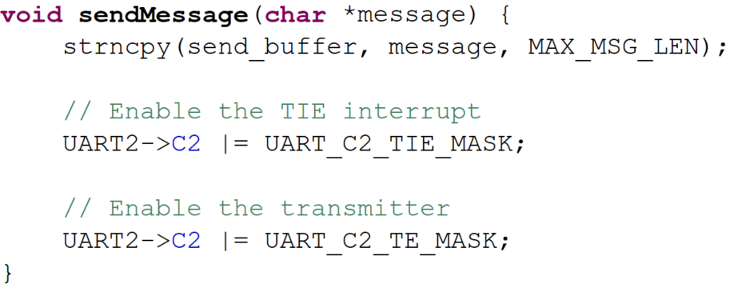
Transmitting Data with Interrupts
We can copy the data to be sent into a buffer first, then enable TE and TIE to start the transmitter.

Slide 27
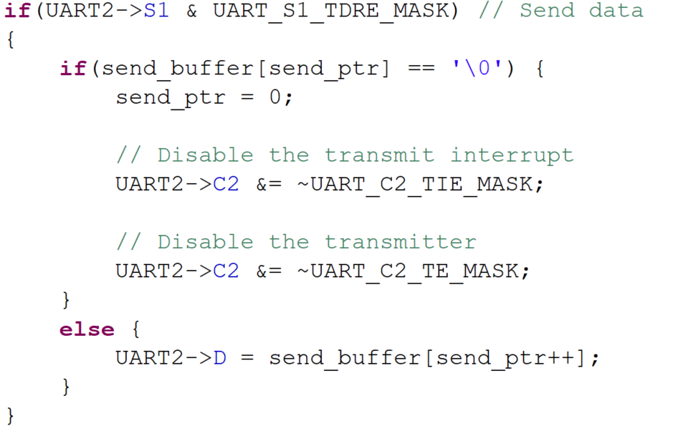
Transmitting Data with Interrupts
Handling Transmitter Interrupts:
  Triggered when the transmitter is ready to send the next character.
    Write to UARTx_D to send the data.
    Disable TE and TIE when there is no more data to send.

Slide 28
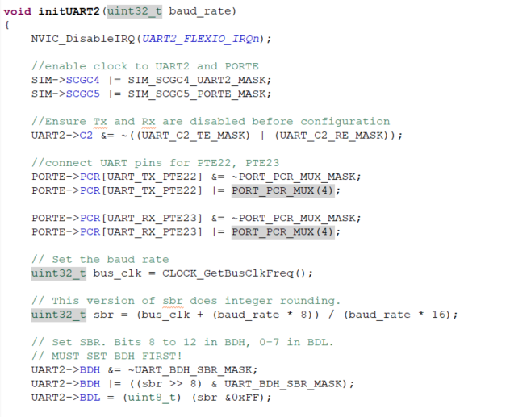
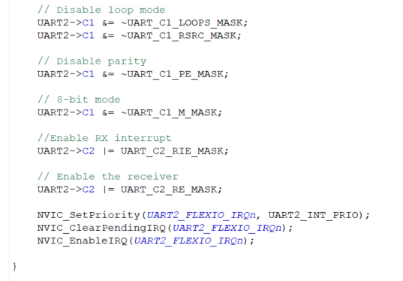
Full UART Setup Code (Interrupts)

Slide 29
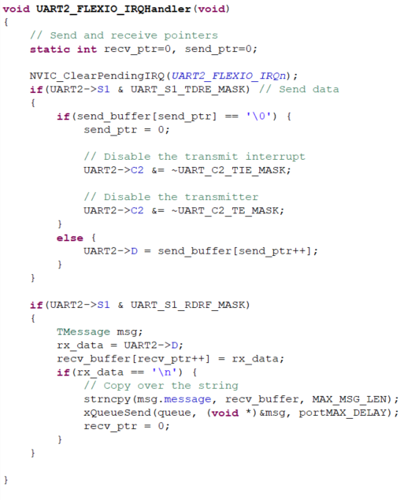
Full ISR

Slide 30
Conclusion
This is the last lecture on programming the hardware for the MCXC444.
Together with the previous FreeRTOS lecture, you are now equipped to build sophisticated real-time systems centred around the ARM-Cortex M0+ family of microcontrollers.

